Slide 1
Virtual Memory and Video Buffering

Slide 2
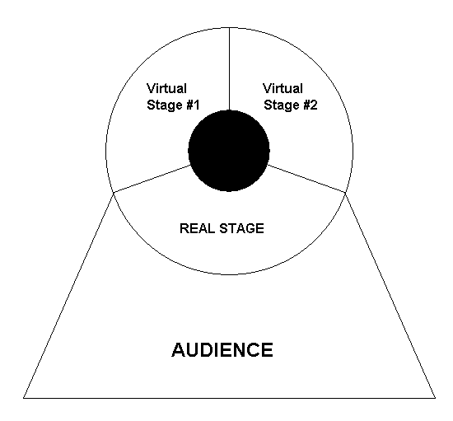
Virtual Memory and Video Buffering

Slide 3
Buffering Program Examples

Slide 4
import java.awt.*;
import java.applet.Applet;
public class GraphicsExCont1 extends Applet{
int appletWidth; // width of the Applet window
int appletHeight; // height of the Applet window
public void init(){
appletWidth = getWidth();
appletHeight = getHeight();
}
public void paint(Graphics g){
g.setColor(Color.BLACK);
g.fillRect(0,0,appletWidth,appletHeight);
}
}

Slide 5
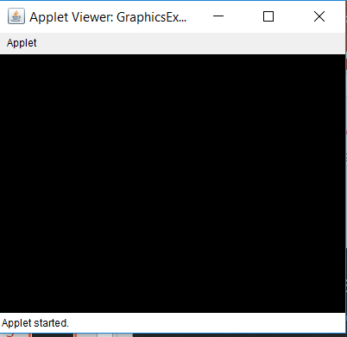
GraphicsExCont1 Output

Slide 6
import java.awt.*;
import java.applet.Applet;
public class GraphicsExCont2 extends Applet {
int appletWidth; // width of the Applet window
int appletHeight; // height of the Applet window
public void init() {
appletWidth = getWidth();
appletHeight = getHeight();
}
public void paint(Graphics g) {
g.setColor(Color.BLACK);
g.fillRect(0,0,appletWidth,appletHeight);
drawSnowman(g,20,200);
}
public void drawSnowman(Graphics g, int x, int y) {
g.setColor(Color.WHITE);
g.fillOval(x+20,y,40,40);
g.fillOval(x+10,y+35,60,60);
g.fillOval(x,y+90,80,80);
}
}

Slide 7
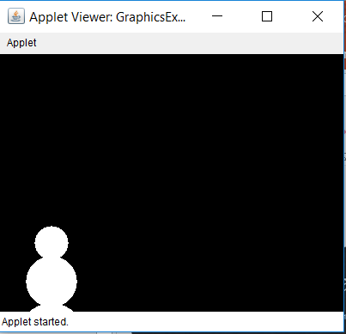
GraphicsExCont2 Output

Slide 8
public class GraphicsExCont3 extends Applet{
int appletWidth;
int appletHeight;
public void init(){
appletWidth = getWidth();
appletHeight = getHeight();
}
public void paint(Graphics g){
g.setColor(Color.BLACK);
g.fillRect(0,0,appletWidth,appletHeight);
for (int x = 20; x < 700; x += 100) {
drawSnowman(g,x,200);
eraseSnowman(g,x,200);
}
}
public void drawSnowman(Graphics g, int x, int y){
g.setColor(Color.WHITE);
g.fillOval(x+20,y,40,40);
g.fillOval(x+10,y+35,60,60);
g.fillOval(x,y+90,80,80);
}
public void eraseSnowman(Graphics g, int x, int y){
g.setColor(Color.BLACK);
g.fillRect(x,y,80,170);
}
}

Slide 9
The output is not visible
since the snowman moves
across the screen so fast.

Slide 10
IMPORTANT NOTE
The next few programming examples demonstrate computer animation.
While an attempt will be made to duplicate the animation affects with PowerPoint, you need to compile and execute the programs for yourself to truly see the program output.

Slide 11
public class GraphicsExCont4 extends Applet{
/**
* SAME AS GraphicsExCont3
**/
public void paint(Graphics g){
g.setColor(Color.BLACK);
g.fillRect(0,0,appletWidth,appletHeight);
for (int x = 20; x < 700; x += 100) {
drawSnowman(g,x,200);
eraseSnowman(g,x,200);
}
}
/**
* SAME AS GraphicsExCont3
**/
public void delay(int n){
long startDelay = System.currentTimeMillis();
long endDelay = 0;
while (endDelay - startDelay < n)
endDelay = System.currentTimeMillis();
}
}

Slide 12
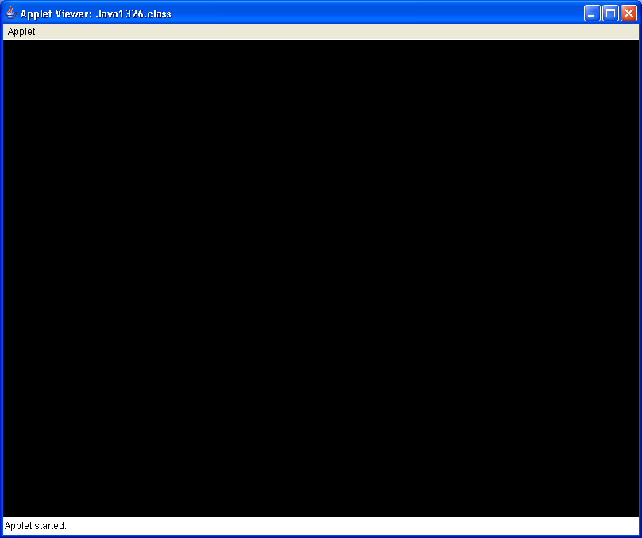
Simulated Output

Slide 13
public class GraphicsExCont5 extends Applet{
int appletWidth;
int appletHeight;
public void init(){
appletWidth = getWidth();
appletHeight = getHeight();
}
public void paint(Graphics g){
g.setColor(Color.BLACK);
createBackGround(g);
for (int x = 20; x < 700; x += 10{
drawSnowman(g,x,200);
delay(50);
eraseSnowman(g,x,200);
}
}
public void createBackGround(Graphics g){
Random rnd = new Random(12345);
for (int k = 1; k <= 1000; k++){
int rndX = rnd.nextInt(750);
int rndY = rnd.nextInt(550);
g.setColor(new Color(rnd.nextInt(256),
rnd.nextInt(256),rnd.nextInt(256)));
g.fillRect(rndX,rndY,50,50);
}
}
/**
* drawSnowman(), eraseSnowman() and
* delay() SAME AS GraphicsExCont4
**/
}

Slide 14
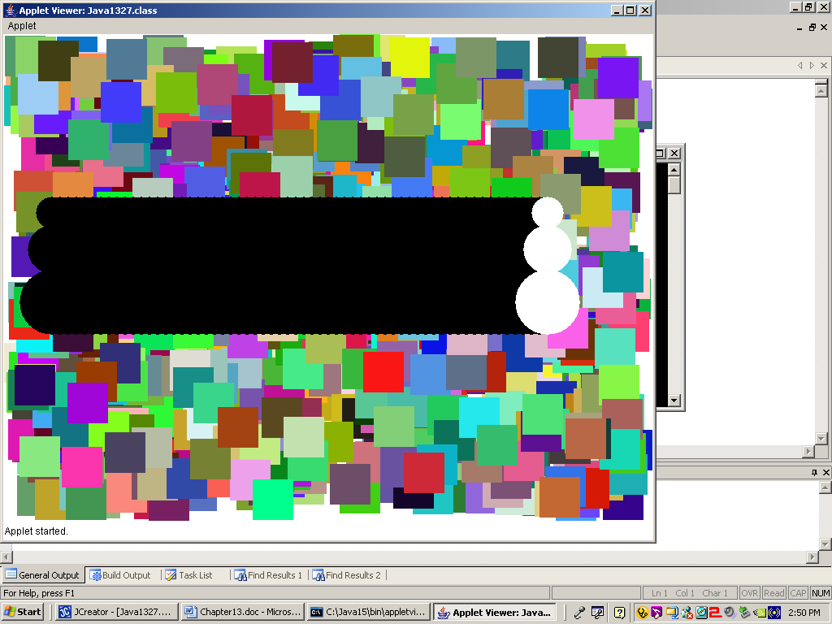

Slide 15
public class GraphicsExCont6 extends Applet{
int appletWidth;
int appletHeight;
Image virtualMem;
Graphics gBuffer;
public void init(){
appletWidth = getWidth();
appletHeight = getHeight();
virtualMem = createImage(appletWidth,
appletHeight);
gBuffer = virtualMem.getGraphics();
}
public void paint(Graphics g){
for (int x = 20; x < 700; x += 5){
drawSnowman(g,x,200);
delay(10);
}
}
public void drawSnowman(Graphics g, int x, int y)
{
createBackGround();
gBuffer.setColor(Color.WHITE);
gBuffer.fillOval(x+20,y,40,40);
gBuffer.fillOval(x+10,y+35,60,60);
gBuffer.fillOval(x,y+90,80,80);
g.drawImage (virtualMem,0,0, this);
}
public void createBackGround(){
Random rnd = new Random(12345);
for (int k = 1; k <= 1000; k++){
int rndX = rnd.nextInt(750);
int rndY = rnd.nextInt(550);
gBuffer.setColor(new Color(
rnd.nextInt(256),
rnd.nextInt(256),
rnd.nextInt(256)));
gBuffer.fillRect(rndX,rndY,50,50);
}
}
public void delay(int n) // same as before
}

Slide 16
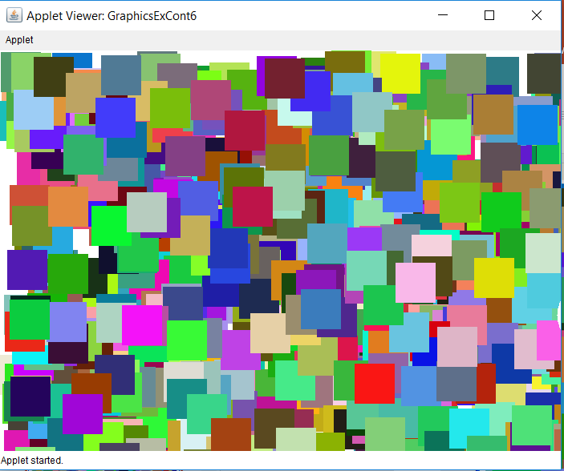
Simulated Output

Slide 17
public class GraphicsContEx7 extends Applet{
Image virtualMem;
Graphics gBuffer;
int oldX, oldY, newX, newY;
int appletWidth, appletHeight;
public void init(){
appletWidth = getWidth();
appletHeight = getHeight();
virtualMem = createImage(appletWidth,appletHeight);
gBuffer = virtualMem.getGraphics();
gBuffer.setColor(Color.white);
gBuffer.fillRect(0,0,appletWidth,appletHeight);
}
public void paint(Graphics g){
gBuffer.setColor(Color.black);
gBuffer.drawString("Move inside the applet to draw", 20,20);
gBuffer.setColor(Color.blue);
gBuffer.fillRect(oldX,oldY,2,2);
g.drawImage(virtualMem,0,0,this);
}
public boolean mouseDown(Event e, int x, int y){
newX = x;
newY = y;
oldX = newX;
oldY = newY;
repaint();
return true;
}
public boolean mouseDrag(Event e, int x, int y){
newX = x;
newY = y;
oldX = newX;
oldY = newY;
repaint();
return true;
}
}

Slide 18
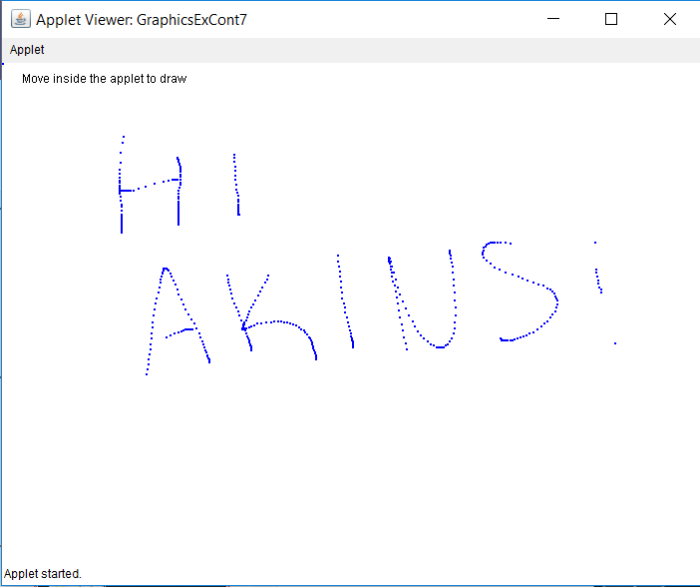

Slide 19
public class GraphicsContEx8 extends Applet{
Image virtualMem;
Graphics gBuffer;
int oldX, oldY, newX, newY;
int appletWidth, appletHeight;
public void init(){
appletWidth = getWidth();
appletHeight = getHeight();
virtualMem = createImage(appletWidth,appletHeight);
gBuffer = virtualMem.getGraphics();
gBuffer.setColor(Color.white);
gBuffer.fillRect(0,0,appletWidth,appletHeight);
}
public void paint(Graphics g){
gBuffer.setColor(Color.black);
gBuffer.drawString("Move inside the applet to draw", 20,20);
gBuffer.setColor(Color.blue);
gBuffer.fillRect(oldX,oldY,2,2);
g.drawImage(virtualMem,0,0,this);
}
// mouseDown and mouseDrag are the same as before
public void update(Graphics g){
paint(g);
}
}
Same as before, but not less flickery

Slide 20
The Magic of Method Update

Slide 21
public class GraphicsExCont9 extends Applet{
int xCoord;
int yCoord;
boolean firstPaint;
public void init() { firstPaint = true; }
public void paint(Graphics g){
if (firstPaint)
firstPaint = false;
else{
g.setColor(Color.red);
g.fillRect(xCoord,yCoord,15,15);
}
}
public boolean mouseDown(Event e, int x, int y){
xCoord = x; yCoord = y;
repaint();
return true;
}
public void update(Graphics g) { paint(g); }
}
Notes:
// Java2131.java
// This program draws small squares using the <update> method rather than
// using arrays to store coordinate values.

Slide 22
public class GraphicsExCont10 extends Applet{
int startX,startY,endX,endY;
public void paint(Graphics g){
g.drawLine(startX,startY,endX,endY);
}
public void update(Graphics g){
paint(g);
}
public boolean mouseDown(Event e, int x, int y){
startX = x;
startY = y;
return true;
}
public boolean mouseDrag(Event e, int x, int y){
endX = x;
endY = y;
repaint();
return true;
}
}

Slide 23
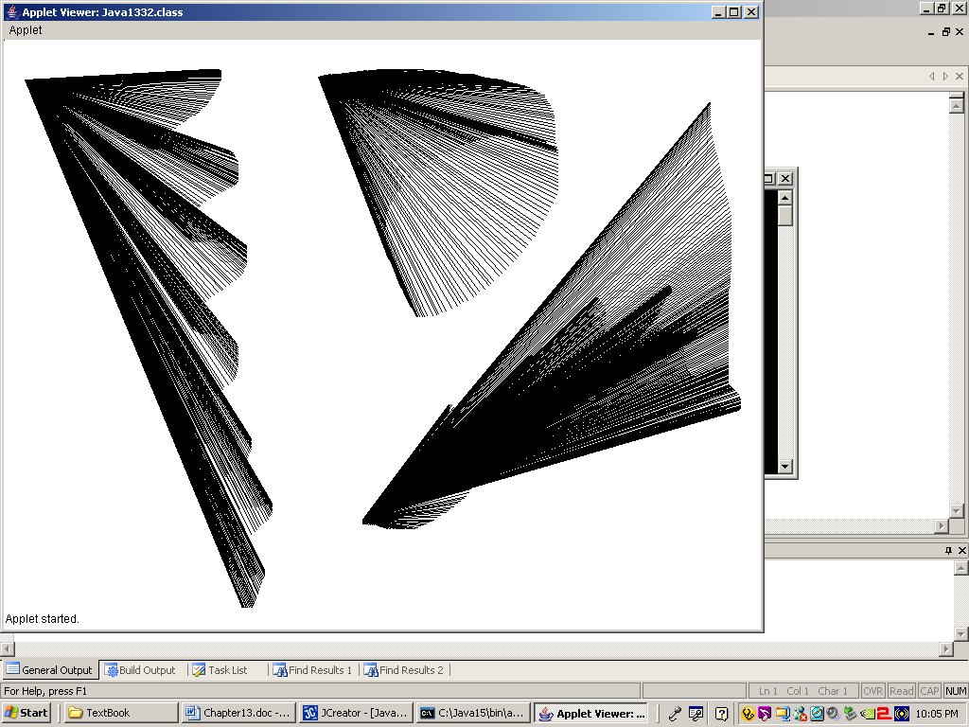

Slide 24
Importing Images

Slide 25
public class GraphicsExCont11 extends java.applet.Applet{
Image picture;
public void init(){
picture=
getImage(getDocumentBase(),“Akin.gif");
}
public void paint(Graphics g){
g.drawImage(picture,0,0,this);
g.drawImage(picture,600,150,this);
g.drawImage(picture,300,400,this);
}
}

Slide 26
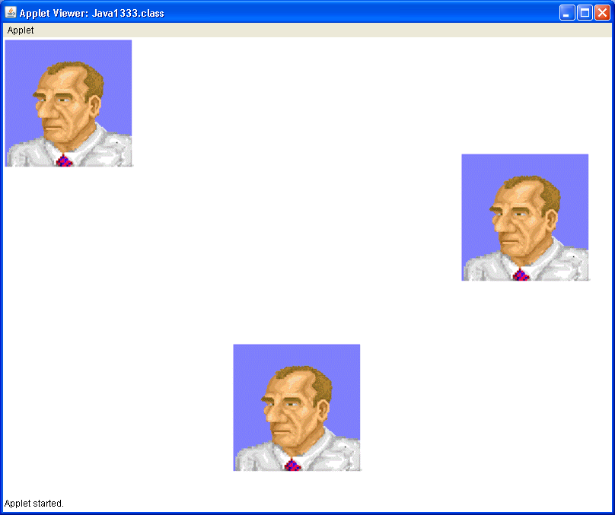
0,0
600,150
300,400

Slide 27
public class GraphicsExCont12 extends java.applet.Applet{
Image picture1, picture2, picture3, picture4;
public void init(){
picture1 = getImage(getDocumentBase(),"LSchram.gif");
picture2 = getImage(getDocumentBase(),"JSchram.jpg");
picture3 =
getImage(getDocumentBase(),"ShortCircuit.bmp");
picture4 = getImage(getDocumentBase(),"bunny.png");
}
public void paint(Graphics g){
g.drawImage(picture1,0,0,this);
g.drawImage(picture2,300,0,this);
g.drawImage(picture3,50,300,this);
g.drawImage(picture4,400,400,this);
}
}

Slide 28
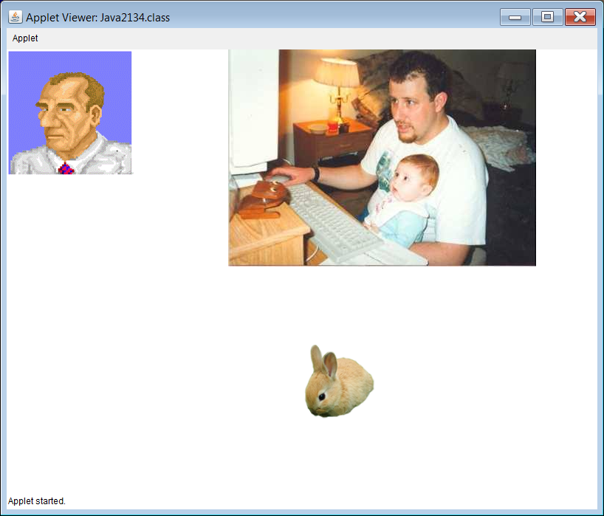

Slide 29

This is the
bmp image
that was
NOT displayed.

Slide 30
public class GraphicsExCont13 extends java.applet.Applet{
Image picture1, picture2, picture3, picture4, picture5, picture6;
public void init()
{
picture1 = getImage(getDocumentBase(),"space.gif");
picture2 = getImage(getDocumentBase(),"computer.gif");
picture3 = getImage(getDocumentBase(),"gears.gif");
picture4 = getImage(getDocumentBase(),"butterfly.gif");
picture5 = getImage(getDocumentBase(),"pizza.gif");
picture6 = getImage(getDocumentBase(),"jet.gif");
}
public void paint(Graphics g)
{
g.drawImage(picture1,100,100,this); g.drawImage(picture2,450,100,this);
g.drawImage(picture3,700,100,this); g.drawImage(picture4,100,400,this);
g.drawImage(picture5,400,350,this); g.drawImage(picture6,700,400,this);
}
public void update(Graphics g) { paint(g); }
}
Check the output
on your computer

Slide 31
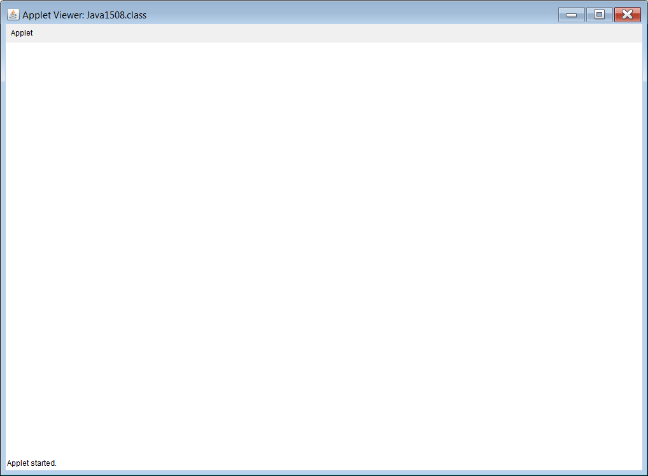
Simulated
Output

Slide 32
Multi-Page Output

Slide 33
public class GraphicsExCont14 extends java.applet.Applet{
int numClicks;
public void init() { numClicks = 0; }
public void paint(Graphics g){
switch (numClicks){
case 0: page1(g); break;
case 1: page2(g); break;
case 2: page3(g); break;
}
}
public boolean mouseDown(Event e, int x, int y){
numClicks++;
repaint();
return true;
}

Slide 34
public void page1(Graphics g){
g.setFont(new Font("Arial",Font.BOLD,100));
g.drawString("TITLE PAGE",200,100);
g.setColor(Color.red);
g.fillRect(300,300,200,200);
g.setFont(new Font("Times Roman",Font.PLAIN,20));
g.drawString("Click once to continue",100,500);
}
public void page2(Graphics g){
g.setFont(new Font("Arial",Font.BOLD,100));
g.drawString("PAGE 2",200,300);
g.setColor(Color.blue);
g.fillRect(0,0,100,100);
g.setFont(new Font("Times Roman",Font.PLAIN,20));
g.drawString("Click once to continue",100,500);
}
public void page3(Graphics g){
g.setColor(Color.green);
g.fillRect(100,100,300,300);
g.setFont(new Font("Arial",Font.BOLD,100));
g.drawString("PAGE 3",200,500);
g.setFont(new Font("Times Roman",Font.PLAIN,20));
g.drawString("Click to exit",400,600);
}
}

Slide 35
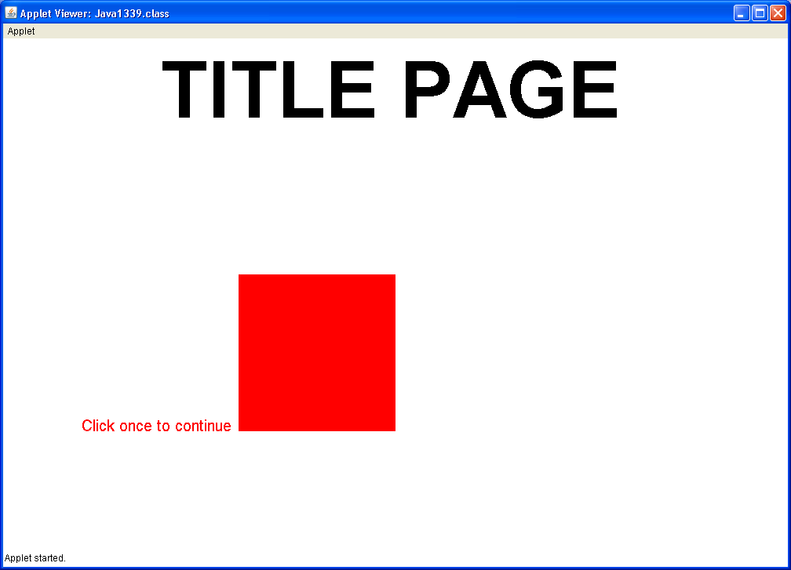

Slide 36
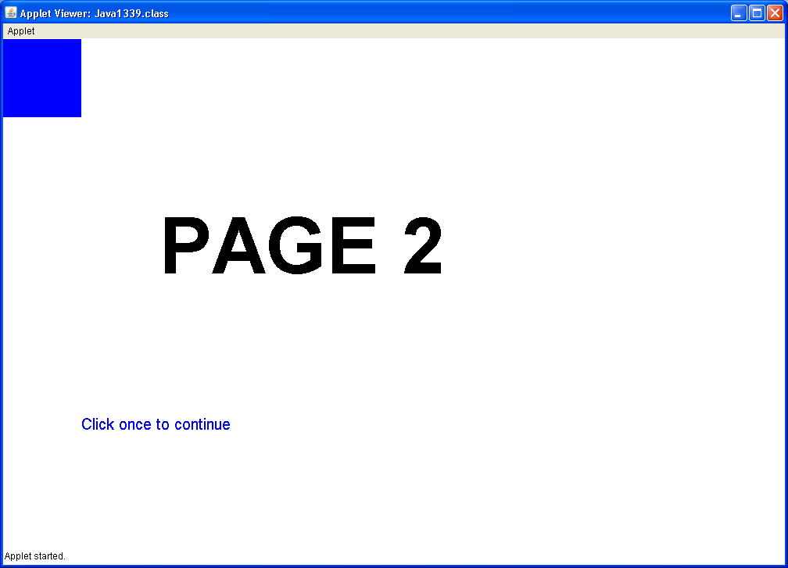

Slide 37
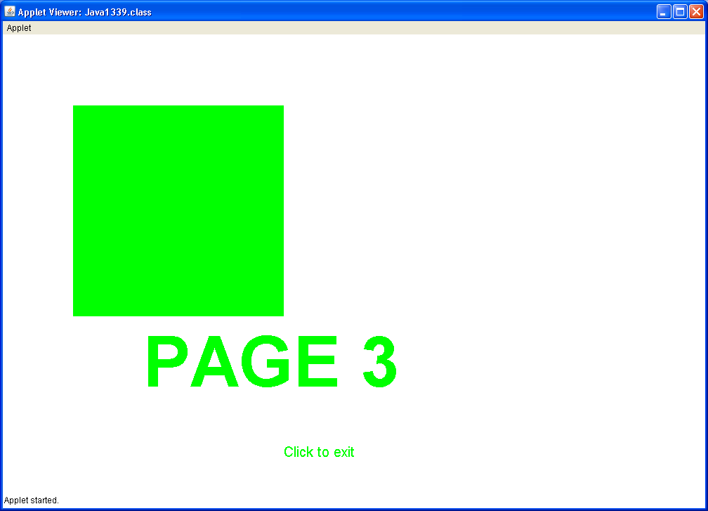

Slide 38
Program Input with GUI Windows

Slide 39
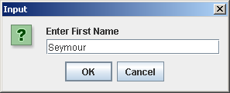

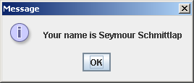
public class GraphicsExCont15{
public static void main (String args[]){
String firstName =
JOptionPane.showInputDialog("Enter First Name");
String lastName = JOptionPane.showInputDialog("Enter Last Name");
String fullName = firstName + " " + lastName;
JOptionPane.showMessageDialog(null,"Your name is " + fullName);
System.exit(0);
}
}

Slide 40
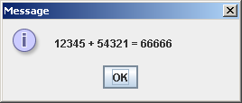
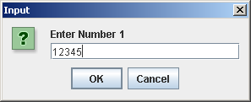
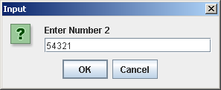
public class GraphicsExCont16{
public static void main (String args[]){
String strNbr1 =
JOptionPane.showInputDialog("Enter Number 1");
String strNbr2 =
JOptionPane.showInputDialog("Enter Number 2");
int intNbr1 = Integer.parseInt(strNbr1);
int intNbr2 = Integer.parseInt(strNbr2);
int sum = intNbr1 + intNbr2;
JOptionPane.showMessageDialog(null,intNbr1 + " + " + intNbr2 +
" = " + sum);
System.exit(0);
}
}

Slide 41
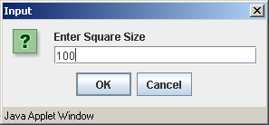
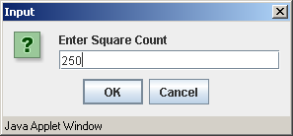
public class GraphicsExCont17 extends JApplet{
int size; // size of squares to be displayed
int count; // the quantity of squares to be displayed
public void init(){
String str1 = JOptionPane.showInputDialog("Enter Square Size");
String str2 = JOptionPane.showInputDialog("Enter Square Count");
size = Integer.parseInt(str1);
count = Integer.parseInt(str2);
}
public void paint(Graphics g){
Random rnd = new Random(12345);
for (int k = 1; k <= count; k++) {
int x = rnd.nextInt(800-size);
int y = rnd.nextInt(600-size);
int red = rnd.nextInt(256);
int green = rnd.nextInt(256);
int blue = rnd.nextInt(256);
g.setColor(new Color(red,green,blue));
g.fillRect(x,y,size,size);
}
}
}
The rest of the output on the next slide

Slide 42
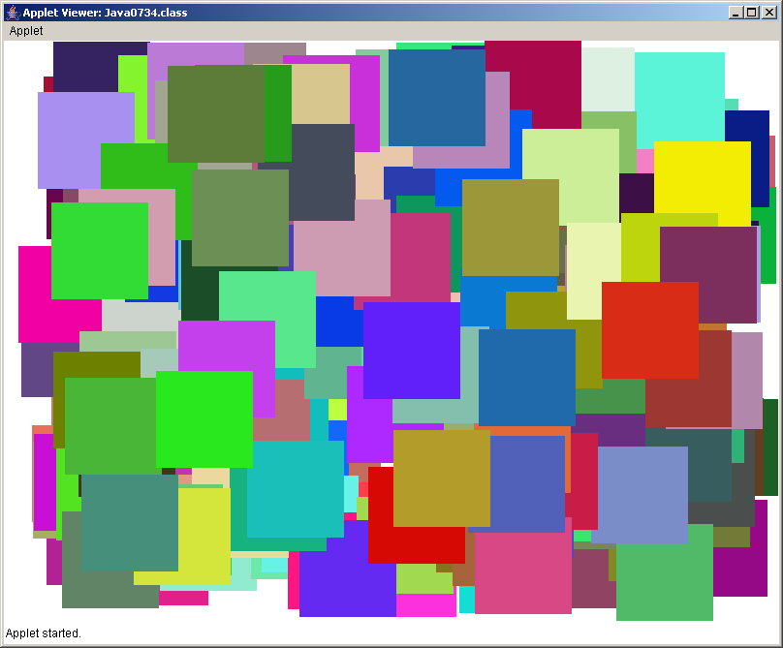
Run the program again,
and enter different values!

